Slide 1
Website Quality: Acquia Optimize
Training 2 for Web Leads, Developers and Content Editors

Slide 2
Zoom Webinar Trainings
JAN. 27 - 3:00 P.M.
Part 1: Introduction to Acquia Optimize
Recording
FEB. 10 - 2:00 P.M.
Part 2: Managing Website Quality at Ohio State
Recording

Slide 3
Part 1 covered
Acquia Optimize User Interface
Dashboard
Policies (Content checks, Dictionaries)
Quality Assurance module (bad links, misspellings)
SEO module
Report Center (download, view, or email reports)
Chrome plug-in

Slide 4
What we will cover today
Role management and structuring work
Managing your dictionary for success
Ohio State content policies
Running periodic quality scans
Broken links
Broken images
Misspellings
Search Optimization

Slide 5
Roles and Processes
Who and how to use Acquia Optimize

Slide 6
Roles
Web Lead
Content Editor
Web Developer
Area Admin for Acquia Optimize
Primary Technical Contact
Who should use this tool?
Web Lead (cares about SEO, Accessibility, Content, Policies) – all web leads should have access.
We’ll continue to communicate with Web Leads.
Web Leads organizes the processes for using these scans.
Request Optimize tool access for other people on teams. https://go.osu.edu/web-quality
Who else may have roles?
Content editors care about content policy, SEO, quality.
Web developers care about link quality, accessibility, some policies that affect performance.
Technical manager (Accessibility, set-up Heartbeat, Quality)
Area Administrator manages your account; manages access for your unit.
Work together to determine the best use of time.
Notes:
There are a number of roles, not every unit works the same. So you’ll want to decide who wears these hats.

Slide 7
Area Admins
We do want one person from each unit to be an area administrator for Aquia Optimize.
Access requests
Dictionary
Locate your area admin if you have questions about your domains.
Fisher?
Web Lead
Content Editor
Web Developer
Area Admin for Acquia Optimize
Primary Technical Contact
Notes:
Area administrator – Thank you! You can locate your area admin.

Slide 8
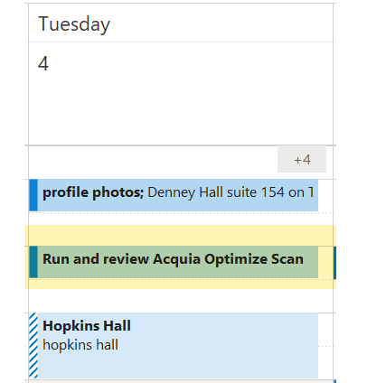
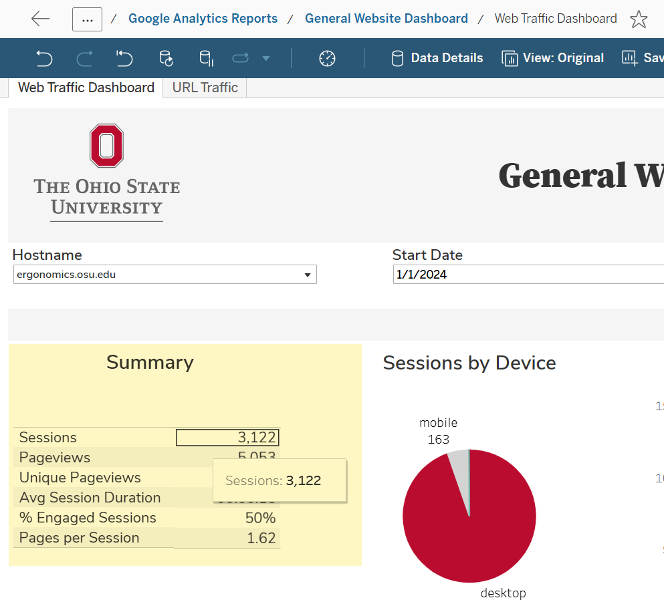
Work Processes
Two ways to integrate this into work.
Schedule a quality review when you launch fresh pages or sites.
Schedule a monthly or quarterly scan review according to your website risk. The most visited pages or web sites should be reviewed more often for quality.
A4 – Critical >40,000 Users (scan should be weekly)
A3 – High 10,001 – 40,000 Users (scan should be monthly)
A2 – Medium 501 – 10,000 Users (scan should be quarterly)
A1 ‐ Low <= 500 Users (scan should be quarterly)
More information: https://omc.osu.edu/analytics-overview/analytics-dashboards
Use the reporting dashboard to find your visitor traffic. https://go.osu.edu/tableau-access-request
Schedule reviews in your calendars, Workfront or project management.

Slide 9
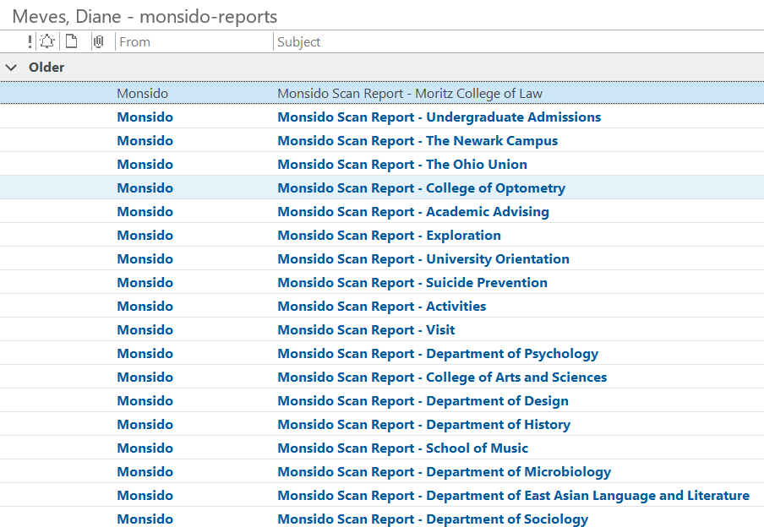
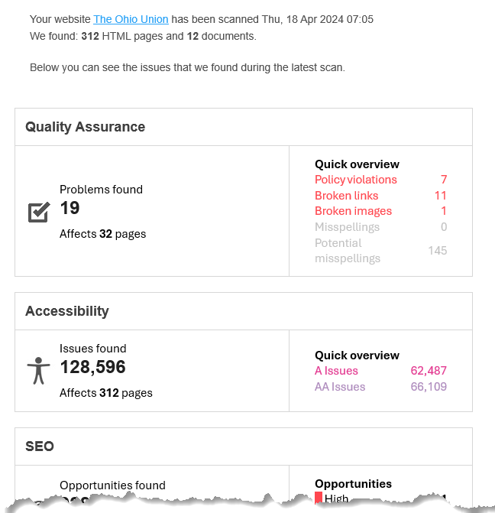
Emailed Reports
Do you want emails?
Emailed Reports can be scheduled.
Weekly report email contains the numbers on your scorecard. Is it helpful?
One email for each website.
Too many emails? Turn them off if you don’t use them.
Instead, set yourself a recurring calendar reminder to run scans on demand.
Start with no emailed reports and then see if they help.

Slide 10
A good work-study job
Managing a Work-Study Student for website quality
Give students valuable job experience and skills in a light framework. If you manage over 300 content pages/files, you might have enough work to hire a student.
One student can be deployed for quality assurance tasks. ($10-$12/hour 8-10 hours per week? Budget $1400 per semester.)
Job Responsibilities.
Receive tool training. (1 hour)
Weekly work – run and review a scan (1 hour)
Email Broken links/images report to tech lead (.5 hours)
Research spelling errors for names / manage dictionary. (2 hours)
Write meta title and descriptions for pages, Report SEO issues to web lead (2 hours)
Review questions and progress with manager and write up weekly notes/additions, next steps, documentation blog (1-2 hours)
Skilled students can also be given CMS editor work or tasked to convert Old PDF files to HTML pages.
Notes:
Some students can handle more than one website.

Slide 11
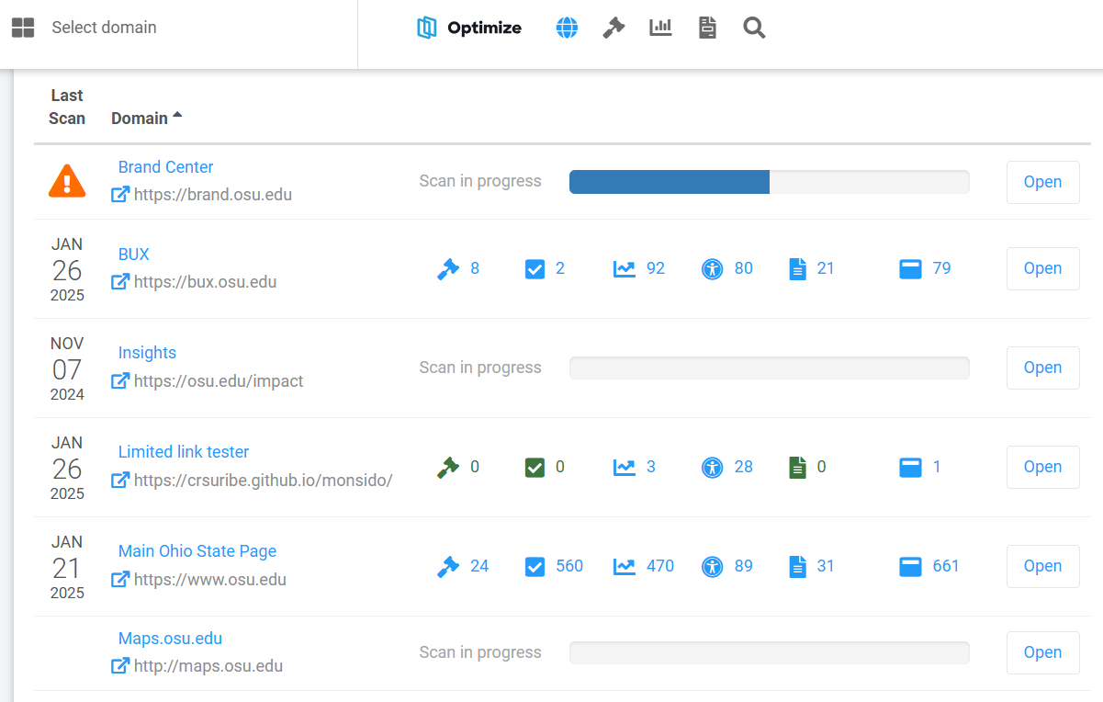
Access multiple domains
Multiple accounts can see multiple domains. Be in the right domain when you use Chrome Extension.
Switch Accounts
Pause a problem scan
Scan in Progress
Start a new scan on demand
How often should your site scan?
30 days or weekly?
Your Area Admins will set the frequency of your scans for each domain.
For scans more often, you may need to exclude Acquia IP addresses from web reports.
Notes:
(after slide pause for Derrick to preview)

Slide 12
Use the Chrome Extension
Login to Acquia Optimize (be checked into the right account/domain)
Open a webpage and manage your extensions in your browser.
Content Issues Panel shows you 5 categories:
Date of last scan
Quality Assurance
Accessibility
Policies
SEO
Page information panel shows you character counts of your title, headings, and meta data.
Plug-in extension shows you page issues in semi-real-time
Notes:
Chrome Plug-in

Slide 13
Managing your Dictionary and Content Policies
Set your scans for success

Slide 14
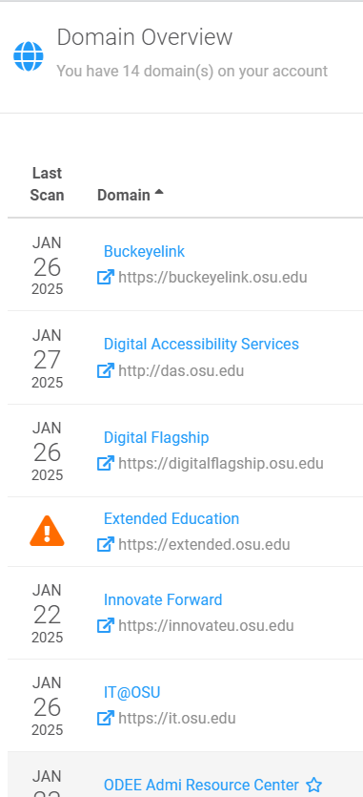
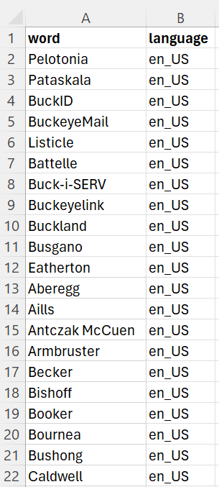
Dictionary
Acquia Optimize scans words according to your dictionary, so take time to give it the correct dictionary.
Dictionaries are shared by the whole account. If you have multiple domains, web leads for each domains can contribute their words. For example, OTDI has 14 domains in one account.
If you have more than 100 words (Faculty names, proper names, building names, acronyms, program names) prepare them in a simple CSV file.
(example template at left)– word and language: acquia-optimize-dictionary-template.xlsx - Name yours with your unit name: acquia-optimize-dictionary-UNIT.xlsx
Best practice: Review your content policies and dictionary annually

Slide 15
Dictionary (2)
Account Groups can work with their Acquia Area Admin to modify their dictionary. The Optimize Team will upload your words to a shared dictionary.
This will be a big help to avoid 600 misspellings that are just names.
Best practice:
Fix spelling as you go.
Add items to dictionary as you go.
Review your dictionary annually.

Slide 16
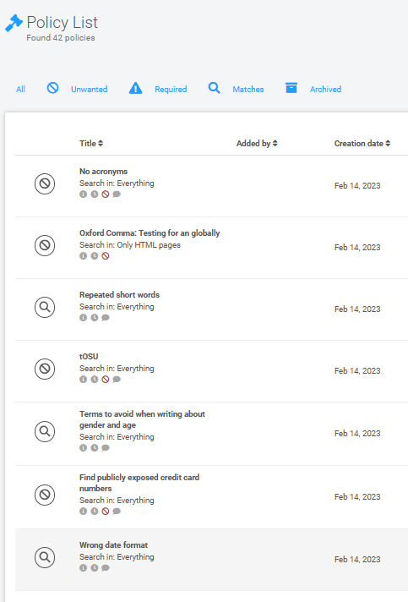
Content policies
Content policies are similar to account-level dictionaries. Content policies are written to find content or code, whether good or bad.
Unwanted content: acronyms, images over 500kb, incorrect phone number format, terms to avoid when referring to students, and more.
Required content: Global tag manager, accessibility policy link,
Maintains your own content policies at the account level.
Best practice: Review your content policies annually. Be consistent in addressing unwanted content.
Download the suggested, global content policies for Ohio State: https://go.osu.edu/content-policies
Let us know if you have ideas for suggestions or Ohio State policies. websupport@osu.edu

Slide 17
Content policies (2)
What are some types of content you want to look for?
Outdated content? Create a policy that looks for Years (2020, 2019, 2018) and you can remove old events.
Faculty or leaders by name
Demo: Let’s show you how to locate these and add a new policy.
https://new.monsido.com/32060/policies/summary
Example : new content policy. Excessive Exclamation points
We know you're excited but keep content to one exclamation point.
Search for: !!, !!!, !!!!, !!!!!, !!!!!! (up to 6 exclamation points) in text on pages, alt tags, anywhere.
Notes:
Slide 20 – Derek drop in to add a policy demo.

Slide 18
Complex Content policies?
If you need help creating special REGEX to locate matched content, you can Contact Support with Acquia.

Slide 19
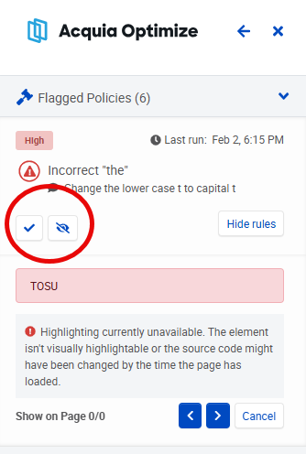
Reviewing your content policy matches.
There are several ways to document your changes as you review your content policy matches.
Did you fix something? Mark it Fixed.
Is the context or use ok for this match? Mark: Ignore it. – That will ignore that issue in this scan.

Slide 20
Review your top web pages
Login to General Web Traffic Dashboard. https://dataviz.rae.osu.edu/
(or https://go.osu.edu/tableau-access-request if you need access.
Choose your domain and choose your dates.
Find and click into the top pages module. This selects it for export.
Choose export. (Cross-tab is an XLS or CSV.) This becomes your worksheet.
Open each page with the chrome plug-in and see what you find.
Best practice: eliminate the issues on your most visited pages.
The Chrome plug-in can help you see problem areas in your most-visited pages.
Notes:
If you have so many pages and can’t tackle all the policies or spellings, start with your most visible pages. This is a good strategy to get started.

Slide 21
Broken links and images
The number one thing most of users find helpful.
Notes:
Broken links and images is one of the most useful

Slide 22
Locate broken links
Choose your domain
Open Quality Assurance module
Under Links category, Choose “Broken Links”
Use the export feature, but select Broken Links Per Page
Download your file.
Review and add instructions.*
Add a priority column and sort your list.
* This is the hard part. When links change, hunting down or making decisions to a remove a link is the time-consuming part.
Download a list of broken links you can schedule to fix.

Slide 23
Locate broken images
Choose your domain
Open Quality Assurance module
Under Links category, Choose “Broken Images”
Use the export feature, but select Broken Image Links Per Page
Download your file.
If your pages are from 2012 and images are long gone, you might do well to just delete the image.* *This is the hard part.
Provide a list of broken images for fixing.

Slide 24
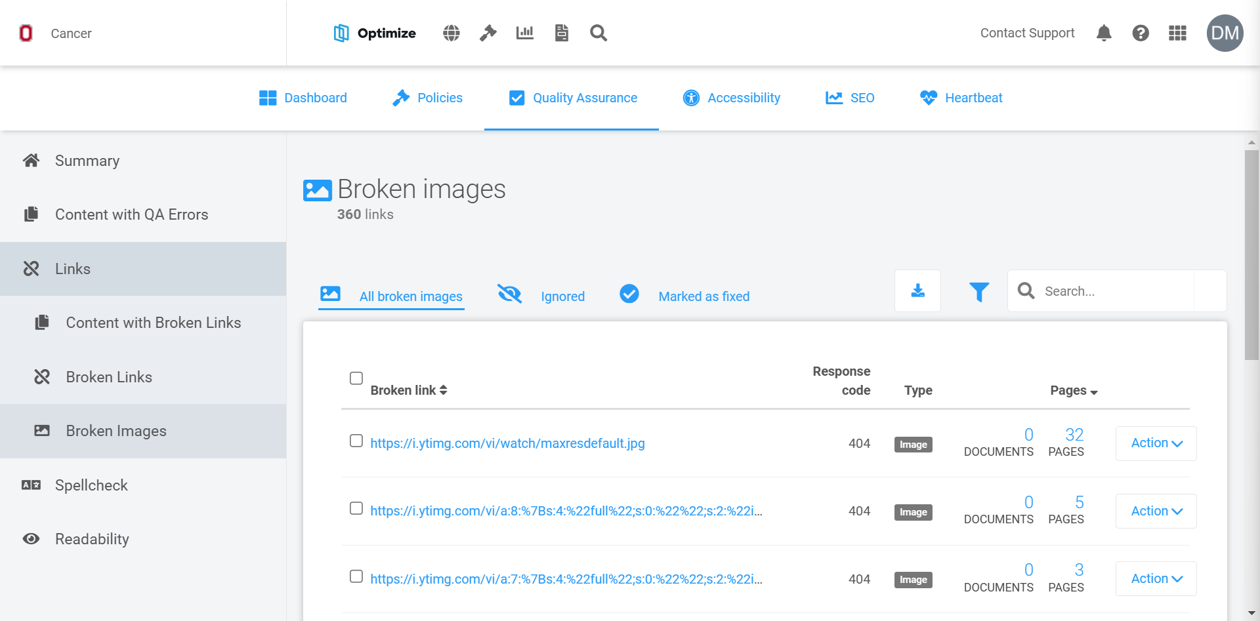
Locate broken images (2)
Images
Notes:
In the Quality Assurance module, We’re under Links, we are looking at Broken images.

Slide 25
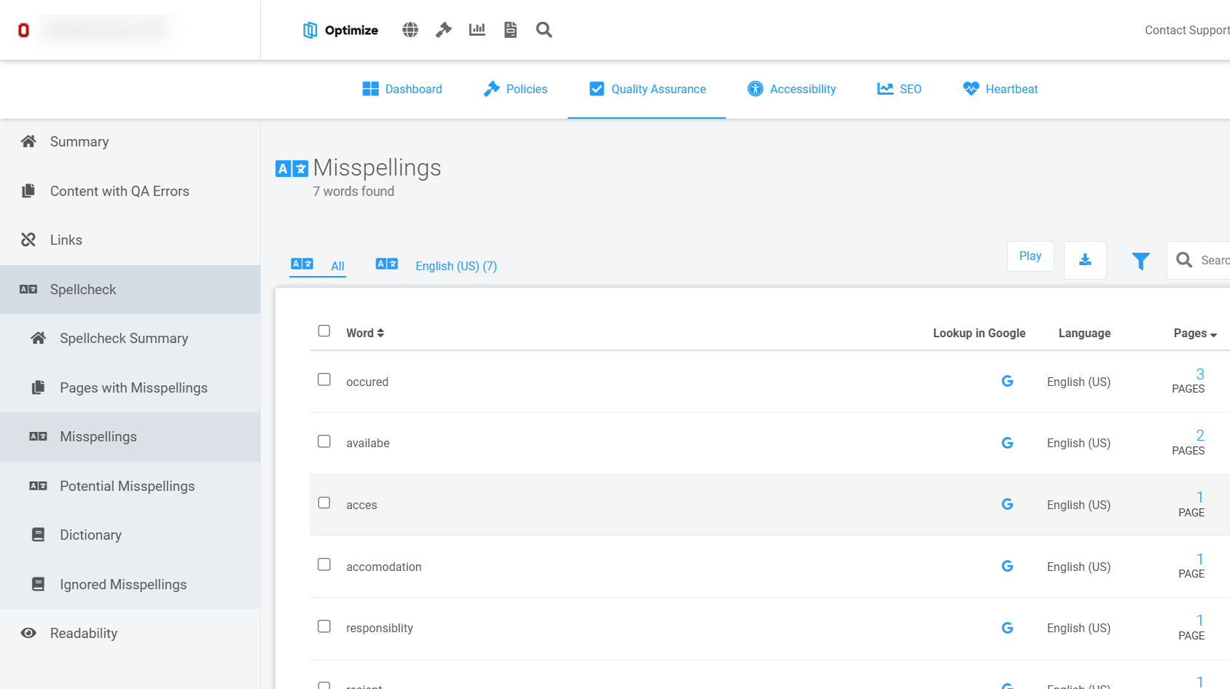
Potential misspellings and misspellings
Correct them if you got’em.

Slide 26
Potential misspellings and misspellings (2)
Confirm as misspelling: Approve this spelling of the word. While not recommended, sometimes writers will be clever.
Mark as fixed: Marks the misspelled word as fixed. It will be included in subsequent scans and if the error returns, it will appear again in the broken links list. Select this option when the misspelled word is actually fixed by the web team on the HTML code of the webpage, or if it is a temporary (for example, in an unpublished state) known issue.
NOTE: The difference between Mark as Fixed and Mark as Ignored is that issues marked as Fixed are still included in future scans and can be flagged again if the error persists.
Issues that are set to Ignore are permanently omitted from future scans and compliance scores.
Only phishing emails have misspelled words.
Add to dictionary: Approve this spelling and add it to the language dictionary so that future scans will not flag it as misspelled. Your best choice to prevent future issues.
Ignore Misspelling - Use this option:
If words, for example proper nouns or names, are marked as misspellings when they are not.
To ignore spelling issues on a single-page basis or to ignore all other issues on a domain level.
Notes:
Only phishing emails have misspellings, so this tool helps you catch your mistakes.

Slide 27
Search Optimization
Help your website get found with organic search

Slide 28
Prime your pages for search
High priority
Distinct meta page title
Missing page title
Missing H1 (header)
Medium Priority
H1 duplicated on other pages
Multiple H1s on one page
Missing subheadings (H2-H6)
Images missing alt tags
If you want more assistance in understanding SEO strategies, visit https://go.osu.edu/seo
Acquia Optimize scans pages to find problems in SEO
Notes:
Acquia is looking at all your pages and calls out the problems in tagging. This is a huge benefit, because if your page isn’t tagged well, you risk people not being able to find your pages.
You can’t have five pages with the same page title and that happens a lot of you duplicate pages.
Page title should be distinct. H1 on every page. You can’t have more than H1. Your images should all have tags. No it can’t tell you if your alt tag is good or necessary, but it can tell you if its missing.
And if you are not using subheads well.

Slide 29
Locate pages with SEO Opportunities
Choose your domain
Open SEO module
Choose Pages with Opportunities category
Review High and Medium Priority pages in the list.
Use the export feature, but select Pages with Opportunities
Download your file.
Provide a list of pages that have SEO issues.

Slide 30
Example download list
The list gives you the title, the URL, priority, issues.
Focus on high issues, then medium.
You or your editor can use this worksheet to add columns for your suggested Titles, H1s, headings, or changes.

Slide 31
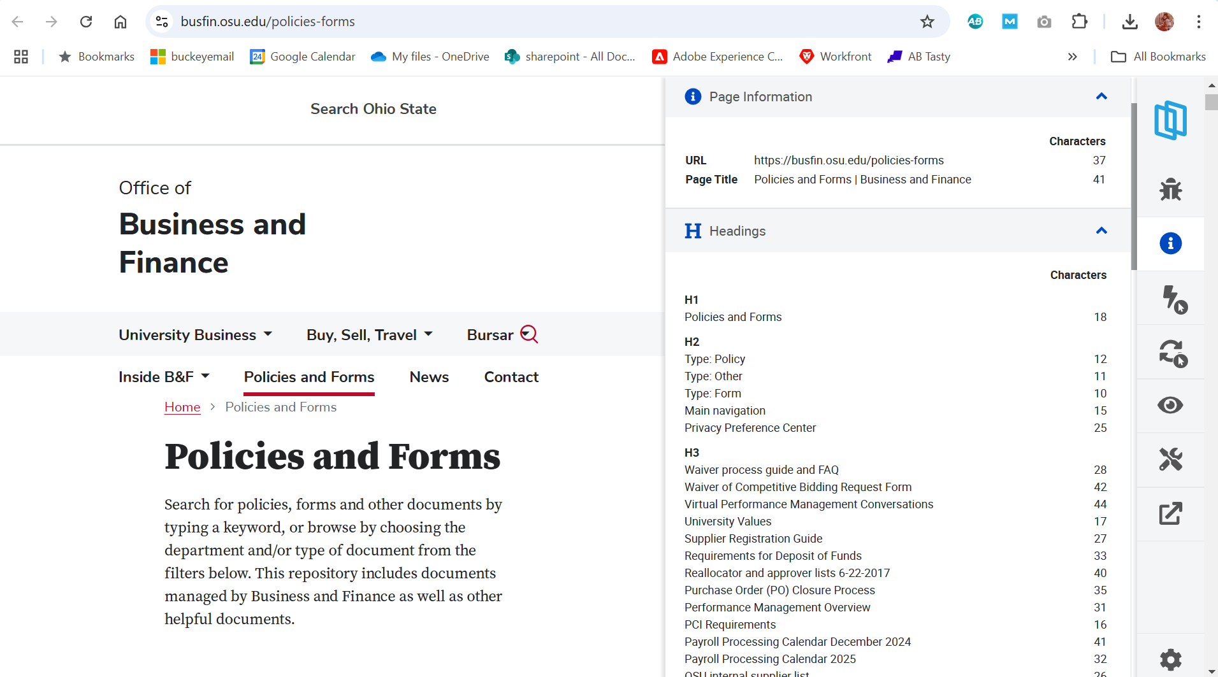
Locate pages with SEO Opportunities (2)
Browser extension can show you all your headings.
Notes:
Here’s an example of the Chrome plugin, used to quickly view the title and H1, and subheads of your pages. Do they make sense? Web editors can review page by page and tweak as necessary.

Slide 32
Knowledge Base and Support
Robust help library and support staff to answer questions

Slide 33
Help and Support
Use Acquia Docs for help and support articles for all of these modules. https://docs.acquia.com/acquia-optimize (located in the top navigation)
Use Acquia Chat Contact Support and they can help address questions on the fly or create the REGEX you need.
Try CoPilot AI for REGEX!
Office of Marketing and Communications websupport@osu.edu for additional trainings.
https://new.monsido.com/ (tool login)
https://go.osu.edu/web-quality (supporting webpage)
We will communicate by email a few times a year to see how everyone is doing.
Help is on the way!
Notes:
Stop recording. Drop links - I keep waiting for them to change the URL from Monsido. We want to hear from you about ways you will use Acquia Optimize to improve your web sites. If there’s a feature everyone needs to know about. Please do tell us about it.

Slide 34
About Accessibility
While Acquia Optimize has an accessibility module, we do not recommend using it.
Instead, focus on the tools and procedures used by your Accessibility coordinator and evaluator. https://accessibility.osu.edu/digital-accessibility-policy/accessibility-coordinators/
Use university-approved tools,

